Slide 1
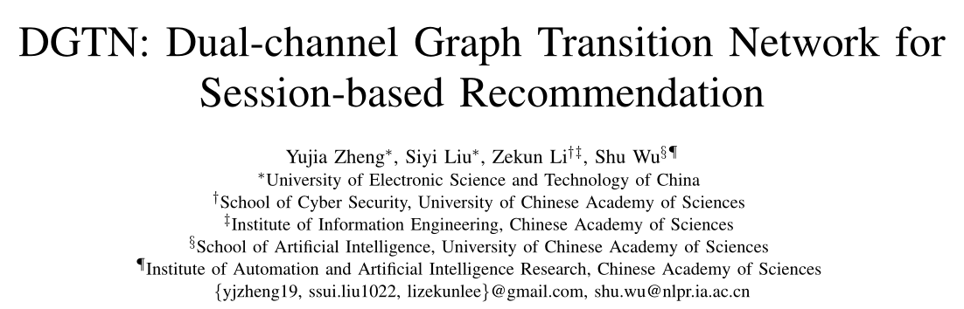
DGTN: Dual-channel Graph Transition Network for Session-based Recommendation
汇报人：Gu Tang
时间：2021.2.23
Meeting:ICDWM
Code:https://github.com/kunwuz/DGTN

Slide 2
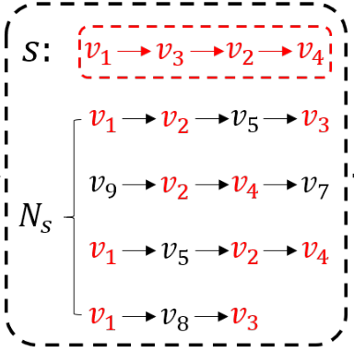
Motivation
Recent research mainly models the target session as a sequence or a graph to
capture item transitions within it, ignoring complex transitions between items in different sessions that have been generated by other users

Slide 3
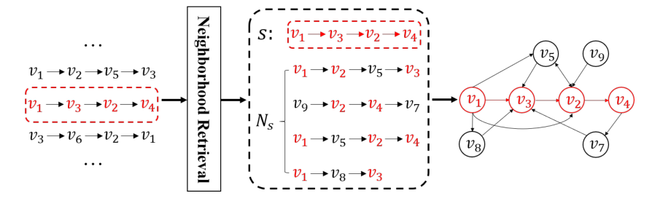
Model Architecture(Build Graph)

Slide 4
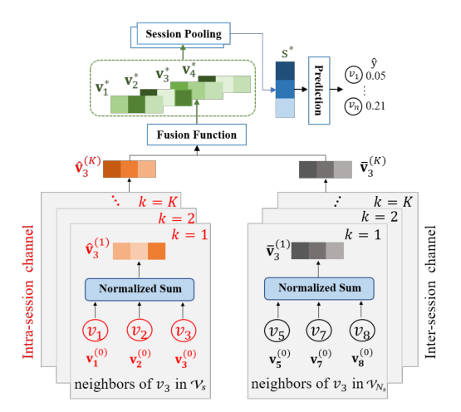
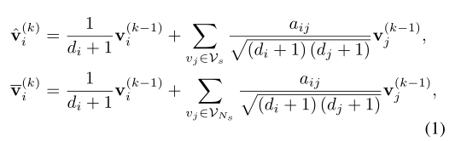


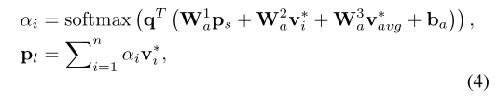




Model Architecture

Slide 5
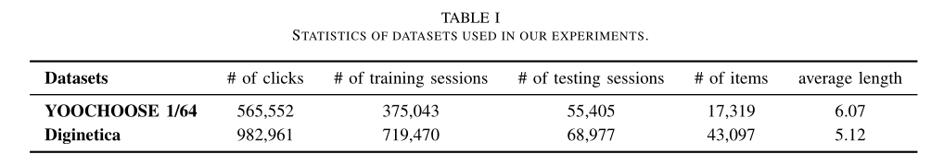
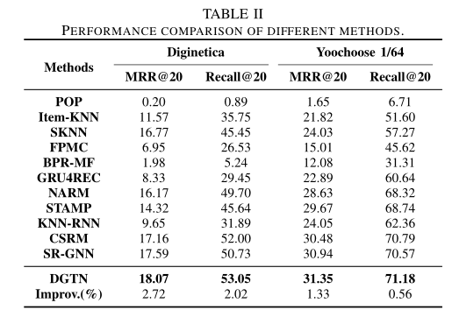
Experiment

Slide 6
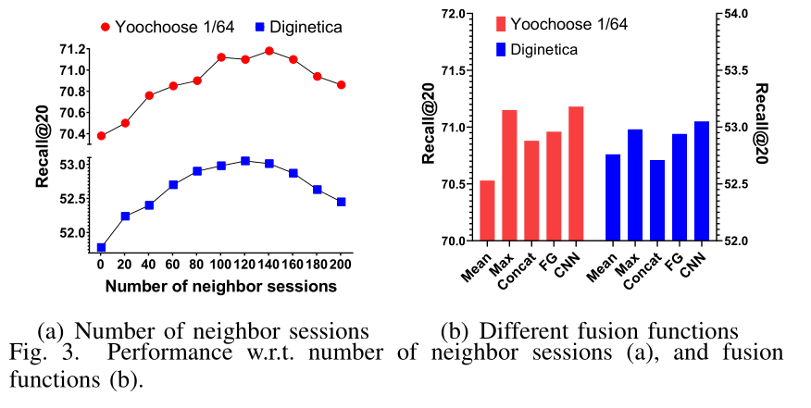
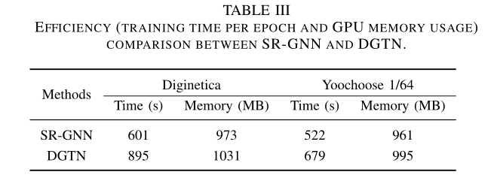
Experiment

Slide 7

THANGKS!

